Slide 1

[CPSC 481]
Stage Five PPT
Brought to you by:
Thaddeus C.

Slide 2

I. Introduction

Slide 3

Overview
Introduction
Design Problem being addressed
Our users/stakeholders, context of activities
Discoveries during research
Major design decisions
Justification of design decisions
Discoveries from heuristic evaluations
How would you address these in the next iteration of design

Slide 4

II. Design problem being addressed

Slide 5

What are we looking at here?
Creating an app for students to act as a platform for both:
Social Development and…
Academic Development

Slide 6

III. Our users/stakeholders

Slide 7


Who are they?
End-users would be students
A list of our stakeholders:
Students
Teaching Assistants (TAs)
Professors

Slide 8

IV. Discoveries during Research

Slide 9

What did we find out about our users?
Out of 111 responses, 73.9% (82) of students preferred to study alone.
70% (78) of students were open to studying with peers.
52% (58) of students were interested in an app to facilitate group study.
From our interviews, we found that students were more interested in to social aspects of the app.

Slide 10

V. Major Design Decisions

Slide 11
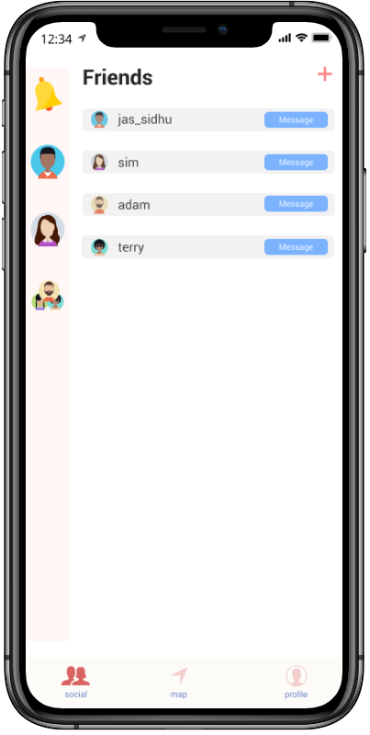
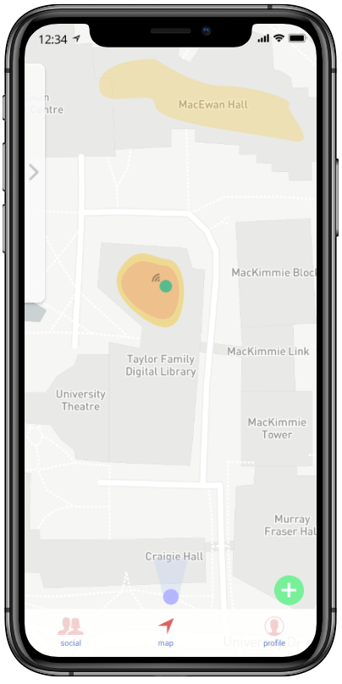
Core Design
3 major tab - each responsible for a host of features.
Social
Map
Profile

Slide 12

VI. Justification of Design Decisions

Slide 13

Core principles we followed
We wanted to keep it Clean and Minimalistic
Main functionality was kept in the map to allow for Data to be Visualized
Match between the App and the Real World
Consistent and standard design throughout this app, and across other apps with similar functionality
Easily learned or is already known

Slide 14

VII. Discoveries from Heuristic Evaluations

Slide 15

What did we find out?
A Lot of our feedback revolved around adding more usability for users to connect with others.
A few examples will follow on the next slide.

Slide 16
Feedback
Some of the major problems (SEVERITY 3):
A user cannot view or edit the event they have created.
The ability to modify the “About” section on profile is missing.
Other issues we covered:
It has been suggested that the ability to invite friends to join an event would be a good feature.
In the notifications, it can be seen when a friend is broadcasting an event. The ability to join the session from that notification would very useful.

Slide 17
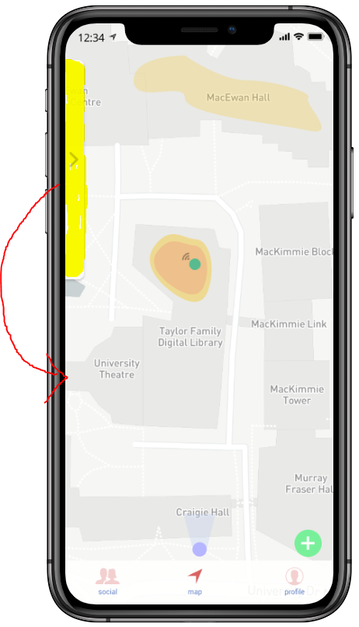
Sidebar Location ~ (SR: 0)
Allowing users to control sidebar location on the map screen.
User is liable to misclick when reaching for the bar.

Slide 18

Lack of Documentation (SR: 0)
Overall lack of help and documentation.
Difficult for users to ascertain which buttons do what, and which ones are interactable.

Slide 19
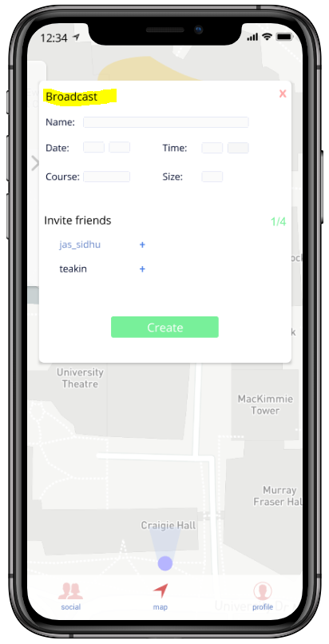
Broadcast Screen ~ (SL: 0)
Implementation of an additional screen to confirm a creation/joining of an event.
This additional screen should be implemented at the center of the screen as it would allow for additional error prevention.

Slide 20

VIII. Addressing issues in future designs

Slide 21

More social features for users to interact
Although the core functionality for users has been implemented, many of our social features we planned did not make it.
Bitmojis, Rewards system, etc.
Having these features in could help encourage users to interact with each other more.

Slide 22

2. Greater focus on study spaces
As of right now, we only consider spaces as a whole (TFDL, Mackimmie etc.)
It would be useful for users to be able to zoom into a location to pick out certain rooms they wish to work in!

Slide 23
Time for our demo!
https://projects.invisionapp.com/prototype/ck3o0ynod00x3ik015tv1y6bf/play

Slide 24


Any Questions?

Slide 25


